Slide 1

Module III
Continuous Integration and Continuous Delivery

Slide 2
This chapter covers the following topics:
• CI/CD principles
• Using a package manager in the CI/CD process
• Using Jenkins for CI/CD implementation
• Using Azure Pipelines for CI/CD
• Using GitLab CI

Slide 3
Technical requirements
The only requirement for this chapter is to have Git installed on your system, as detailed
in the previous chapter.

Slide 4
CI/CD principles

Slide 5
The setting up of a Git-type source control version (SCV) is a necessary prerequisite that
makes it possible to centralize the code of all the members of a team.
The team will have to decide on a code branch that will be used for CI.
In addition, CI is achieved by an automatic task suite that is executed on a server,
following similar patterns executed on a developer's laptop that has the necessary tools for
CI; this server is called the CI server.
The CI server can be either of the on-premises type, installed in the company data center,
such as Jenkins or TeamCity,

Slide 6
To be able to host this package, we need a package manager, also called a repository
manager, which can be on-premises (installed locally) such as Nexus, Artifactory, or
ProGet, or a software-as-a-service (SaaS) solution such as Azure Pipelines, Azure
Artifacts, or the GitHub Packages registry.

Slide 7
CD
Once the application has been packaged and stored in a package manager during CI, the
CD process is ready to retrieve the package and deploy it in different environments.
During the deployment phase, it is often necessary to modify the configuration of
the application in the generated package in order for it to be adapted to the target
environment. It is, therefore, necessary to integrate a configuration manager that is
already present in common CI/CD tools such as Jenkins, Azure Pipelines, or Octopus
Deploy.

Slide 8
Using Jenkins for CI/CD implementation
Jenkins has become famous thanks to the large community working on it and its plugins.
Indeed, there are more than 1,500 Jenkins plugins that allow you to perform all types of
actions within your jobs. And if, despite everything, one of your tasks does not have a
plugin, you can create one yourself.

Slide 9
Installing and configuring Jenkins
1. To get all the steps to create an Azure VM with Jenkins already installed, read the
documentation available here: https://docs.microsoft.com/en-us/
azure/jenkins/install-jenkins-solution-template.

Slide 10
Once installed and created, we will access Jenkins in the browser by providing its
Uniform Resource Locator (URL) in the Azure portal in the DNS name field, as
shown in the following screenshot:

Slide 11
3. Follow the displayed instructions on the Jenkins home page to enable access to
this Jenkins instance via secure Secure Sockets Layer (SSL) tunneling.
4. Then, follow the configuration instructions on the Unlock Jenkins message
displayed on the Jenkins screen. Once the configuration is complete, we get Jenkins
ready to create a CI job.

Slide 12

Configuring a GitHub webhook
In order for Jenkins to run a new job, we must first create a webhook in the GitHub
repository. This webhook will be used to notify Jenkins as soon as a new push occurs in
the repository.
1. In the GitHub repository, go to the Settings | Webhooks menu.
2. Click on the Add Webhook button.

Slide 13
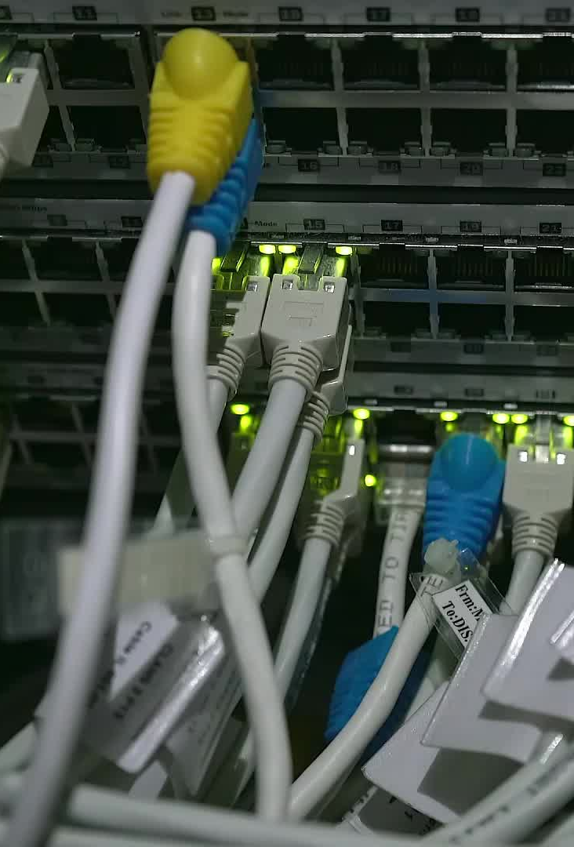
Webhooks
3. In the Payload URL field, fill in the URL address of Jenkins followed by /githubwebhook/,
leave the secret input as it is, and choose the Just the push event
option.
4. Validate the webhook.

Slide 15
Webhooks
5. Finally, we can check on the GitHub interface that the webhook is well configured
and that it communicates with Jenkins.

Slide 16

Using GitLab CI
GitLab CI is one of the services offered by GitLab (https://about.gitlab.com/),
which, like Azure DevOps, is a cloud platform with the following attributes:
• A source code manager
• A CI/CD pipeline manager
• A board for project management
The other services it offers are listed here: https://about.gitlab.com/
features/.

Slide 17

Authentication at GitLab
Creating a GitLab account is free and can be done either by creating a GitLab account or
using external accounts, such as Google, GitHub, Twitter, or Bitbucket.
To create a GitLab account, we need to go to https://gitlab.com/users/sign_
in#register-pane and choose the type of authentication.

Slide 18
GitLab Registration

Slide 19
Gitlab Home page

Slide 20
Creating a new project and managing your source code
Click on Create a project on the home page, as illustrated in the following
screenshot:

Slide 21
To create an empty project (without code), the form asks you to enter the project's
name, as illustrated in the following screenshot:

Slide 22
To create a new project from a built-in template project, proceed as follows:

Slide 23
To import code from an internal or external repository of another SVC platform, this is as shown in the following screenshot:

Slide 24
The code to import is located in an external SVC repository, as shown in the following screenshot:

Slide 25
GitLab
2. Once the project is created, we'll have a page that indicates the different Git
commands to execute to push its code.
3. To do this, on our local disk, we will create a new gitlab-ci-demo.yml file and
then copy the content of our example, which can be found at https://github.
com/PacktPublishing/Learning-DevOps-Second-Edition/tree/
main/CHAP07, in the gitlab-ci-demo.yml file.
4. Then, we will execute the following commands in a terminal to push the code into
the repository

Slide 26
GitLab
git init
git remote add origin <git repo Url>
git add .
git commit -m "Initial commit"
git push -u origin master

Slide 27
Once these commands have been executed, we'll obtain a remote GitLab repository with our lab code

Slide 28

Creating a CI pipeline
In GitLab CI, the creation of a CI pipeline (and CD) is not done via a graphical UI (GUI),
but with a YAML file at the root of the project.
This method, which consists of describing the process of a pipeline in a file that is located
with the code, can be called Pipeline as Code (PaC), in the same way as Infrastructure as
Code (IaC).

Slide 29
image: microsoft/dotnet:latest
stages:
- build
- test
variables:
BuildConfiguration: "Release"

Slide 30
build:
stage: build
script:
- "cd app"
- "dotnet restore"
- "dotnet build --configuration
$BuildConfiguration"
test:
stage: test
script:
- "cd tests"
- "dotnet test --configuration
$BuildConfiguration"

Slide 31
Creating a CI pipeline
We can see at the beginning of this code that we use a microsoft/
dotnet:latest Docker image that will be mounted in a container and in which
the actions of the pipeline will be executed.
Then, we define two stages, one for the build and one for the test execution, as well
as a BuildConfiguration variable that will be used in the scripts.
Finally, we describe each of the stages of the scripts to be executed in their
respective directories. These .NET core scripts are identical to the ones we saw
in the Using Azure Pipelines for CI/CD section.

Slide 32
2. Then, we will commit and push this file into the remote repository.
3. Just after pushing the code, we can see that the CI process has been triggered.

Slide 33
Accessing the CI pipeline execution details
In the GitLab CI menu, go to CI / CD | Pipelines, and you will see a list of pipeline
executions, as shown in the following screenshot:

Slide 34
2. To display the details of the pipeline, we click on the desired pipeline execution,

Slide 35
3. We can see the execution status, as well as the two stages that you defined in the
pipeline YAML file. To view the details of the execution logs for a stage, we click on
the stage.

